Slide 1


Video Head Detection Based on YOLO
Yitao Zhou
12.18.2020

Slide 2
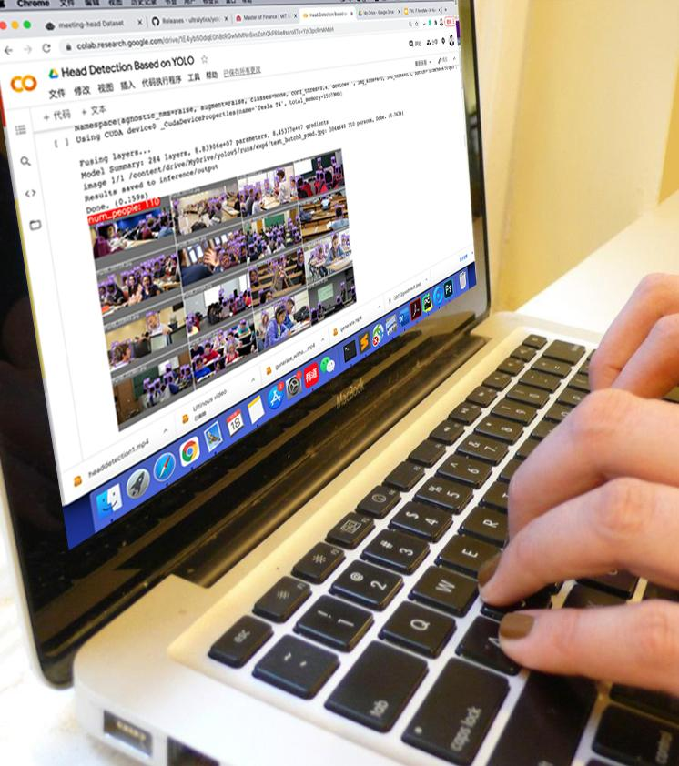
Structure
Introduction
Dataset and Features
Design of Project
Results
Conclusion and Future Works

Slide 3
Introduction

Slide 4
Introduction
Project feasibility
Number of people in our school in increasing drastically
We have guidance for limitation of the number students in each classroom
We also have video surveillance cameras in the classroom
We can utilize the surveillance video to detect and control the number of students in classroom to guarantee safety
*
4
Notes:
4

Slide 5
Introduction
Why You Only Look Once(YOLO)?
YOLO is an object detection algorithm which can detect heads in images
It achieves state-of-the-art mAP in object detection competitions
YOLO has fast speed because each image is feed to the model only once in each epoch, so the training process will be fast
*
5
Notes:
5

Slide 6
Dataset

Slide 7
Dataset
SCUT_HEAD
Gathered and labeled by Southern China University of Technology
Containing 4405 images with 111251 heads
Two parts of data, part A includes 2000 images in a classroom setting, part B includes 2405 images crawled from internet.
Train-Val-Test split 6:2:2
Different label format for what YOLO needs, wrote a program to change the label
*
7

Slide 8
Dataset
Self crawled data from Google
I found 377 images on Google image with keyword “indoor scene”
Tagged with LabelIMG, a famous tool for image labelling, an interesting but tiring process
Augmented with roboflow.com, an online service that randomly applies Flip, Crop, Brightness and Noise to the images, producing 1131 images
*
8

Slide 9
Design of project

Slide 10
Design of project
Part 1: Training
Build a configuration file to declare the location of Train-Val-Test data, specifying the class name: person, class number: 1
Transfer learning with weights trained on COCO dataset
First attempt: Train with SCUT_HEAD. Set batch size 16, image input size 640 and epoch 80
Second attempt: Combine SCUT_HEAD and self crawled dataset. Set batch size 8, image input size 640 and epoch 50.
*
10

Slide 11
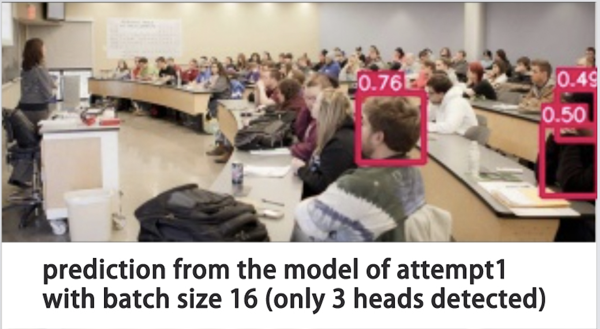
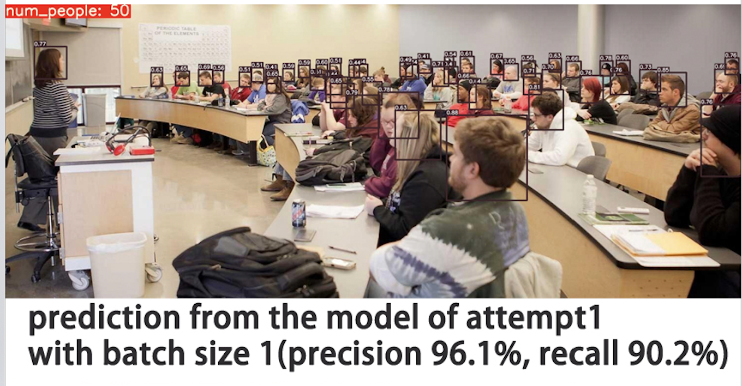
Design of project
Reason for reducing batch size
When batch size is 16, the image is very small because it is 1 out of 16 images, so the testing result is bad. But I attempted to make a test on merely this image (batch size 1), and I get a relatively good result.
*
11

Slide 12
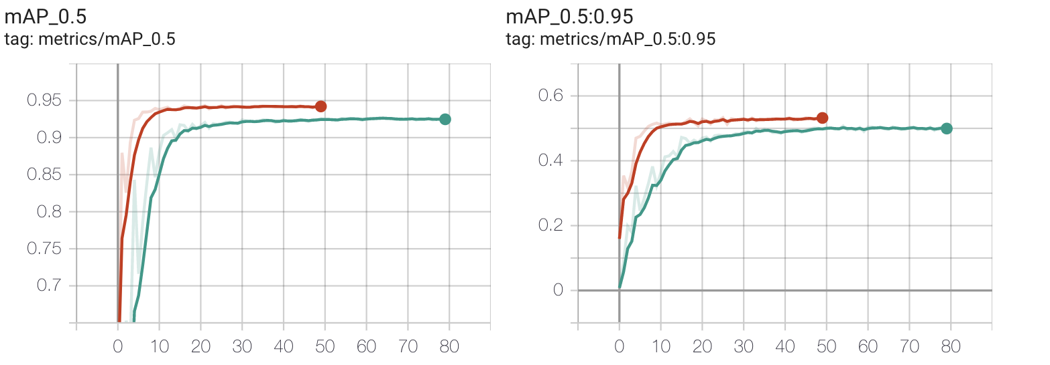
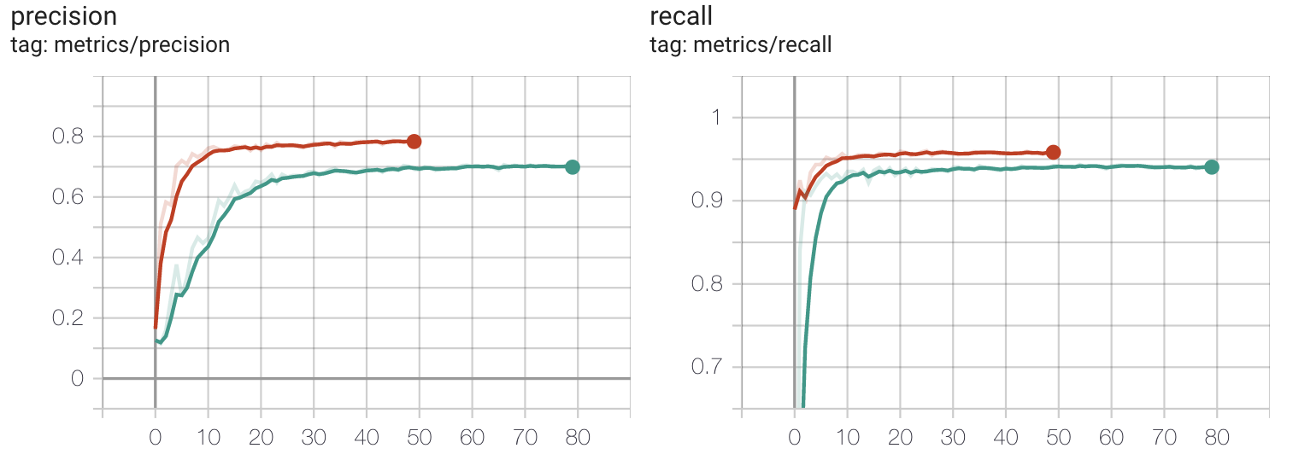
Design of project
Reason for reducing epoches
YOLO converges very quick. In attempt 1, the training evaluations converge after around 50 epoches. To reduce time I use 50 epoches in attempt 2.
Green is for attempt 1 and red is for attempt 2
*
12

Slide 13
Design of project
Test the model robustness with test data in SCUT_HEAD
Mean average precision is the most popular evaluation for object detection.
Attempt 1: mAP@.5 is 0.878. mAP@.5:.95 is 0.484
Attempt 2: mAP@.5 is 0.908, mAP@.5:.95 is 0.526
Attempt 2 works much better, used for predicting the videos
*
13

Slide 14
Design of project
Part 2: Predicting
Since surveillance video is hard to be gathered because of safety concerns, I use prediction video “Thank You, Chancellor Yu” downloaded from school website
Split video data into frames, record the music
All predictions are with confidence threshold 0.4
Predict on how many heads in each frame, label heads in frames, and record the total number of heads in the frames in the upper-left corner, when it exceed our classroom maximum number of people 20, the label will turn red, otherwise green
Concatenate frames back into a video, with its music
*
14

Slide 15
Results

Slide 16
Results
Let’s see how the prediction works for the video!
*
16

Slide 17
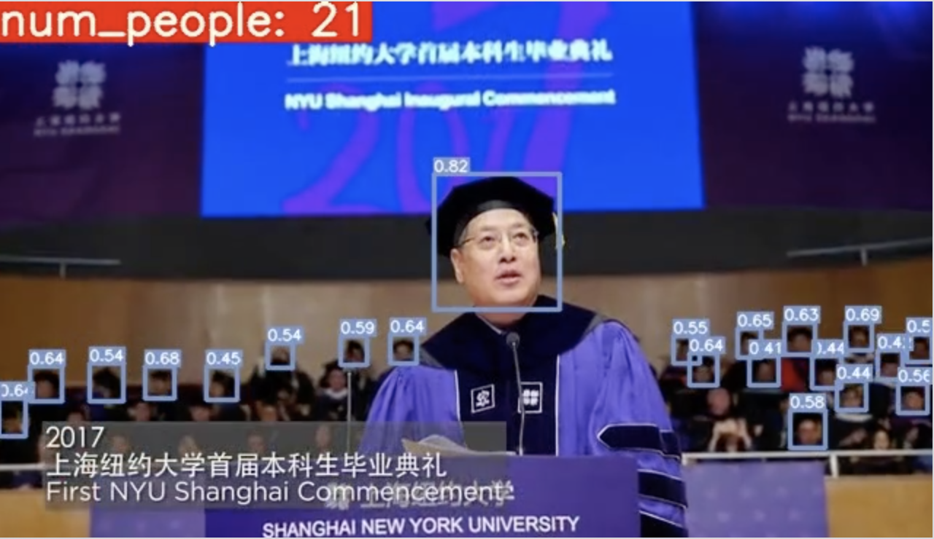
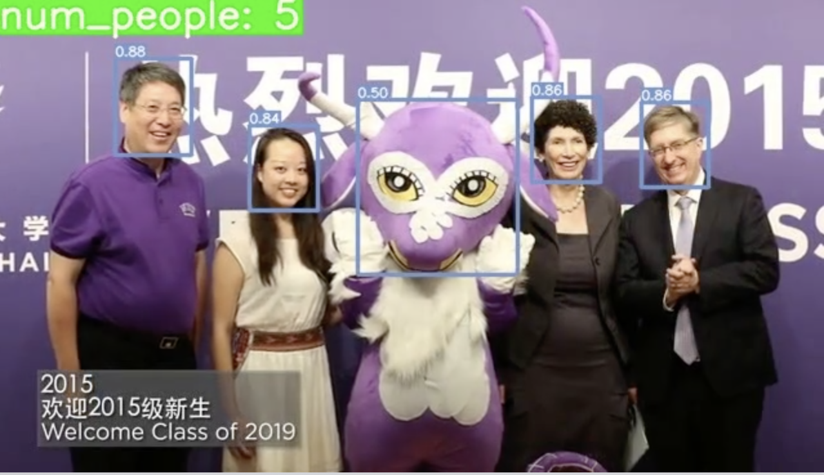
Results
Most of the results are convincing, with few prediction mistakes
Dark and blurred
humanoid mascot
*
17

Slide 18
Conclusion &
Future works

Slide 19
Conclusion
What I learned
How YOLO works
How to modify the model to fit my task
How to find useful data
How to fix bugs during training
How to make predictions
How to improve the prediction result
*
19

Slide 20
Future Works
Future Works
Add trackers to trace the action of each person in the video, therefore, I can guarantee a person will not suddenly miss its label
Adding data could enhance the model robustness with the observation of blur, small heads not being labeled
YOLO has limitations of predicting small objects, using SSD or combine the predictions of YOLO and SSD together might be a good attempt to increase robustness
*
20

Slide 21
Thank you for listening, if you want to see more video predictions, let’s enjoy my prediction on a youtube video!
*
21

